Slide 1
LEADING SELF & OTHERS THROUGH CHALLENGING TIMES
Shauna McMahon, MA (Leadership), CHE, FBCS, FEDIPLdgPra, CHCIO
Chief Information Officer / Executive Team

Slide 3
THE EXCITEMENT OF THE NEW ROLE & WHAT YOUR EXPECTATIONS WERE
THE BUBBLE BURSTS
MENTALLY REGROUPING AND REFRAMING
HITTING YOUR STRIDE AND FINDING JOY AND THE THRILL OF WORKING WITH THE TEAM – WHY AUTHENTIC LEADERSHIP MATTERS

Slide 4
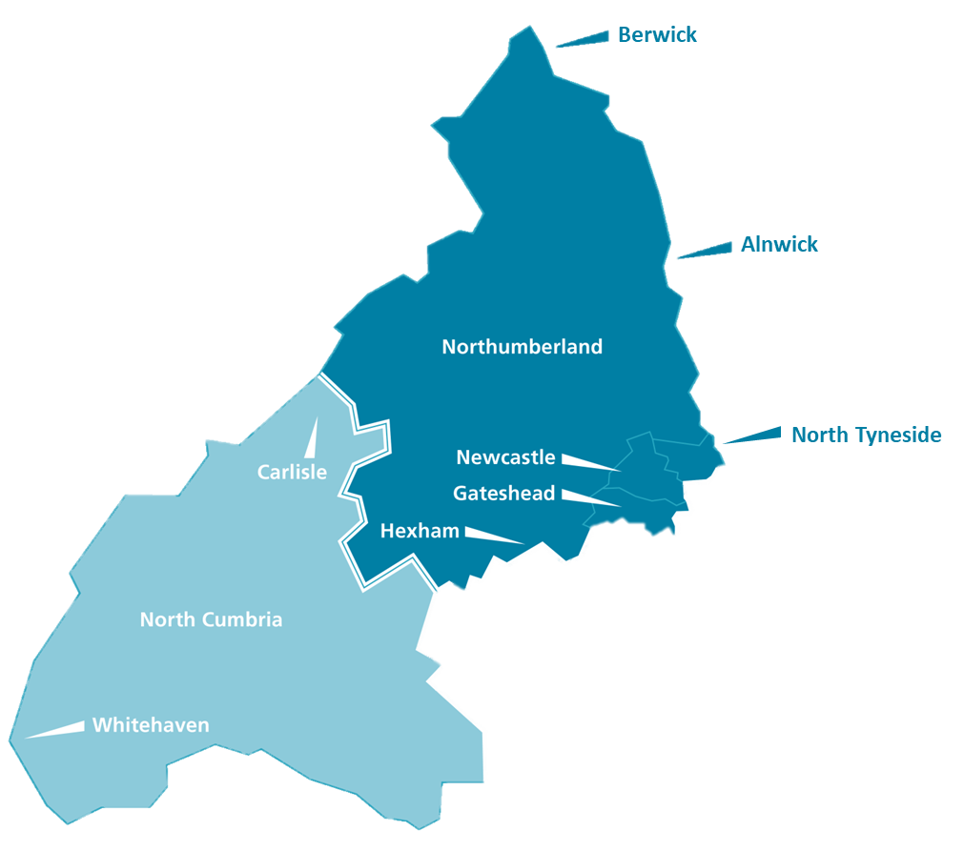
Great North Healthcare Alliance
Four NHS Trusts working together for the benefit of our patients and staff, our local areas and the wider region.
By working together we will:
Improve patient outcomes and reduce inequalities by strengthening our services and making it easier to access the best clinical care.
Create great places to work by joining up our recruitment and staff experience offer and by sharing career development opportunities.
Pioneer innovation, transformation, research and development, making the most of our academic and commercial opportunities.
Reduce health inequalities and do more for our economy, environment and communities through local and national partnerships.
Create a financially sustainable value for money health economy that raises revenue by treating as many patients as possible within the resources available, commercial activity and cost reduction.
Caring for over 1.3m patients over 4,600 square miles
35,000 staff
£3 billion annual spend
*Each Trust will retain its independent identity, and each Trust has the right to opt in or out of proposals, and act appropriately for their organisation and their communities.

Slide 5
Preparing for Retirement I have MERCH!
£20
£15
Finding it after DMA
I survived DMA ‘24
With the help of a good G&T
Digital helps make the
Magic Happen…. Find your inner Houdini
£10

